Slide 1


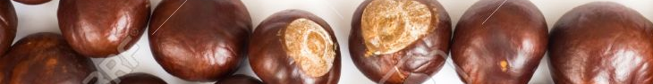
Year 3
Newsletter
Autumn Term
We are excited to welcome you all back to a new term! My name is Miss Fox, and I will be your child’s class teacher this year. I am delighted to be working alongside Mrs Hirst and Mrs Dee, who will continue to support learning in the classroom.
We are looking forward to a fun and engaging term filled with learning, creativity, and growth!
Please ensure children bring a coat to school every day along with their book bag and a water bottle.
Please continue to help your child at home by reading with them every night for 10 minutes.
PE – Sessions will take place every Tuesday. Please ensure that children wear a white t-shirt, black joggers or leggings, and black trainers.
This term we are learning…
English: Children will be creating a direct speech comic strip, retelling the communication between the last pig and the wolf, inspired by The True Story of the 3 Little Pigs. This will help them practise using punctuation for speech and develop their storytelling skills. Guided Reading: We will be reading The Twits by Roald Dahl, exploring character, humour, and the author’s use of descriptive language.
In Maths we will explore place value, addition and subtraction beyond 100.
In History We will begin our topic on Prehistoric Britain. Children will discover what life was like in the Stone Age, including how people lived, hunted, and created tools.
Science: We will explore skeletons and how they help us move, investigate the muscles in our bodies, and learn about nutrition and the digestive system. Children will also study food chains to understand how living things depend on each other.
RE - This term’s question is: "What is the Trinity? Children will explore Christian beliefs about God the Father, the Son, and the Holy Spirit, and reflect on how this idea is shown in worship and prayer.
Art: In art we will focus on painting and mixed media. Children will be inspired by prehistoric cave paintings, experimenting with colour, texture, and natural materials.
Computing: We will explore how the internet works and how information travels across networks.
Music: In music lessons, we will be listening to and performing ballads, learning how music can tell stories and convey emotions.
PE: This term’s focus is on Fundamentals, Developing balance, coordination, and agility.
RSHE (Personal, Social, Health, and Economic Education) Our theme this term is Me and My Relationships – developing teamwork, empathy, and communication skills.

